Slide 1
Interim Oral Interview
‘Assessing blood samples for malaria’

Slide 2
Project’s purpose and inspiration
Purpose
The project aims to implement and test new approaches for the classification and segmentation of malaria samples and assess the significance and validity of the produced results.
This holds great significance as testing new approaches is extremely important in scientific development, exploring multiple methods and writing an appropriate thesis can prove to be beneficial to the scientific community.
With the completion of the project, I will be able to develop a good understanding of this academic field which I think will prove invaluable in the future, and as this topic is deep within the scope of scientific academic research it will help me get a good understanding of how projects similar in nature are carried out.
Inspiration
I became immediately inspired to start working on this project as soon as I read the corresponding literature associated with the topic, and due to the project’s nature being closely intertwined with biology and machine learning, it instantly sparked interest within me.
Reading the corresponding literature gave me the ability to understand the surface level of different methods of research, which subsequently introduced me to other approaches on how to develop the project.

Slide 3
Background research
Clustering-Based Dual Deep Learning Architecture for Detecting Red Blood Cells in Malaria Diagnostic Smears (IEEE JOURNAL OF BIOMEDICAL AND HEALTH INFORMATICS, VOL. 25, NO. 5, MAY 2021)
Estimating malaria parasitemia from blood smear images (Halim et al, Proceedings of the International Conference on Control, Automation, Robotics and Vision, Jan 2006)
An automatic device for detection and classification of malaria parasite species in thick blood film (Kaewkamnerd et al, BMC Bioinformatics, Volume 13, 2012)
Automated image processing method for the diagnosis and classification of malaria on thin blood smears (N. E. Ross and C. J. Pritchard and D. M. Rubin and A. G. Dus\'e, Medical and Biological Engineering and Computing, Volume 44, Number 5, 2006)
Notes:
Clustering:
Uses dual deep learning architecture which can detect red blood cells in thin blood smears
RBCNet architecture uses cell clustering instead of region proposals
Estimating:
Estimating parasitemia from blood smears accounting for uncertain imaging conditions, the method consist of using a multi-stage estimation process which is based on pattern matching with parameter optimization
Segmentation techniques used by previous technology: thresholding, morphology and transformations and dedicated data description models.
An automatic device:
Accurate classification of parasite species suffers from inherent technical limitation of human inconsistency
Automated image:
The algorithm is an image classification problem, therefore takes the form of standard pattern recognition and classification. It consists of four stages: image acquisition, pre-processing, feature generation and classification.
For classification, a tree classifier with two nodes using BFF neural networks determines whether a cell is infected

Slide 4
Background & novelty
Background
In the aforementioned research, many papers focus on discovering effective segmentation methods and usually do not work with classification as its primary way of identifying infected or non-infected parasites. The information in these papers describes different segmentation and classification methodologies, and data augmentation techniques, this is going to be very useful, as development of image segmentation is being focused on in the upcoming term.
When it comes to researching classification, accurate classification of parasite species suffers from inherent technical limitation of human inconsistency, the datasets need to labelled manually before the machine learning model can be trained with the data, therefore a problem like this must be accounted for. This has been considered in our version of the classifier as ‘corrected’ datasets are being implemented.
Novelties in our project
With the use of a manually reclassified data set by a group in Dhaka, we estimate more accurate results on the classification of infected and non-infected cells as the human error that caused mis-classifications in our NIH dataset is eliminated, this however does not mean there are no more mistakes in the dataset, but ultimately increases the accuracy of the trained model.

Slide 5
Autumn term project objectives
The general objective for the first academic term was to develop a classifier with the use of Keras and TensorFlow which could, to a certain degree, successfully identify infected malaria samples from non-infected samples. And to measure the accuracy of the classifier.
To achieve the general objective, we needed to firstly be able to acquire the training data, and subsequently load the training samples into memory. ✓
The next step after loading the data into memory is to manipulate the data into a usable format for the training model to read, this includes flattening the data and normalization of the data, this step is called preprocessing. ✓
After the normalizing step has been completed, we needed to select and implement a training model which would read in the data in the correct format and start the training process. ✓
After trying out different machine learning models, the objective was to find out which of them would produce the most accurate and useful results and then move on to either trying to adjust that model to produce even better results or to adjust our dataset. ✓
The last objective was the evaluation of the machine learning algorithm, which is similar to the previous step however, here we would use special libraries/dependencies which would allow us to, for example; plot the accuracy over time on graphs, or predict the infected state on sets of data based of the trained model ✓

Slide 6
Let's look at this term's activity overview

Slide 7
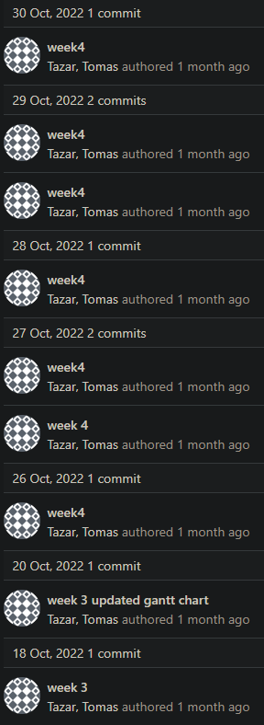
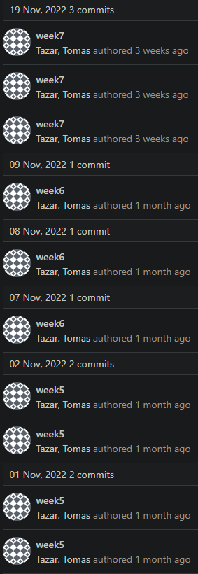
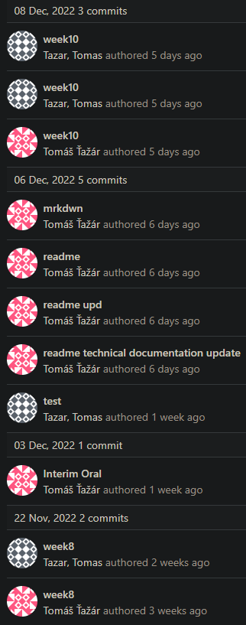
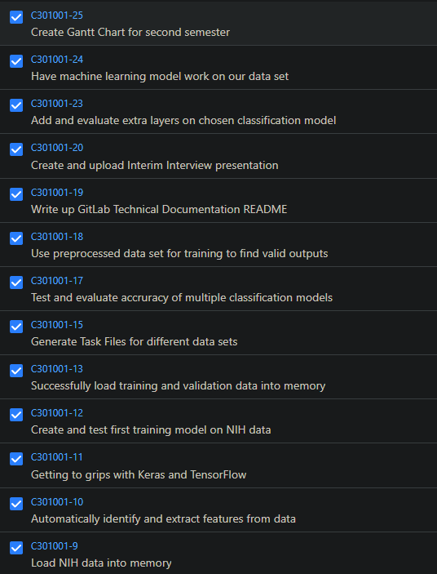
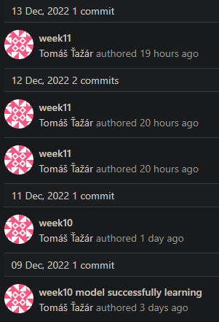
GitLab + Jira activity overview
Change in time

Slide 8
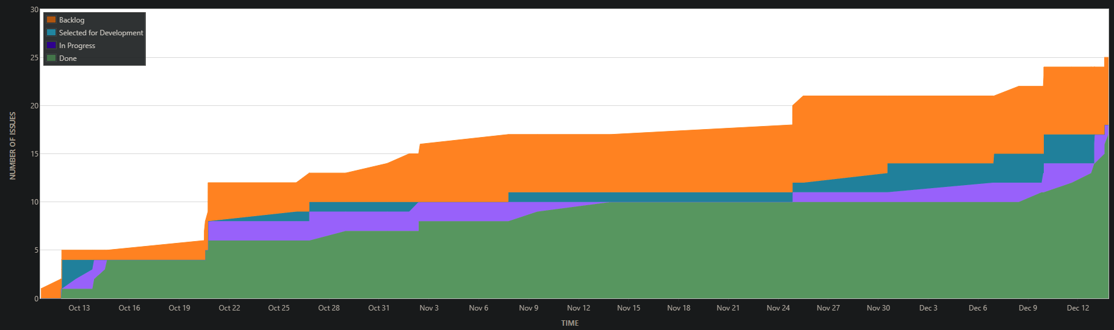
GitLab + Jira activity overview
Cumulative Flow Diagram

Slide 9
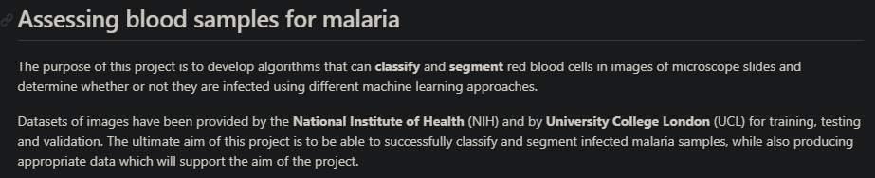
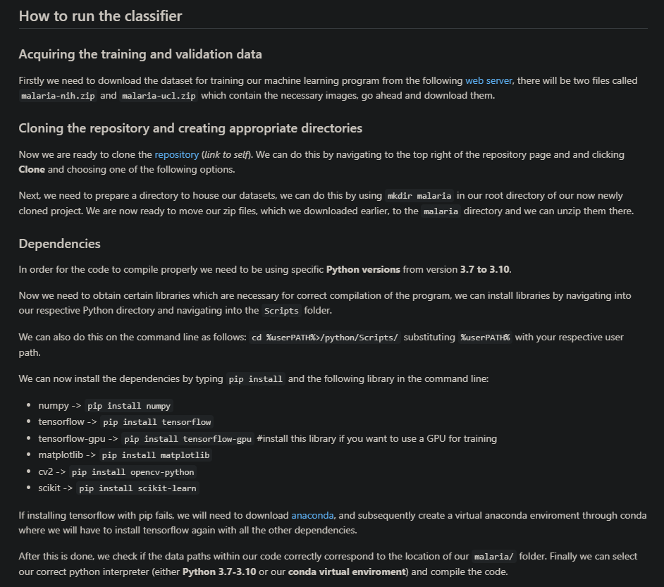
GitLab README overview

Slide 10
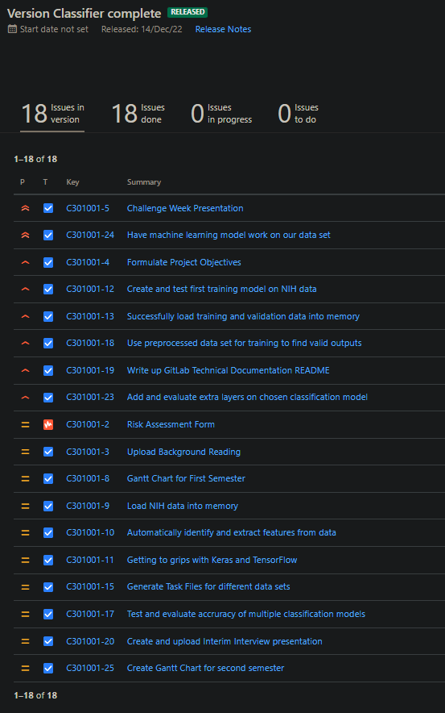
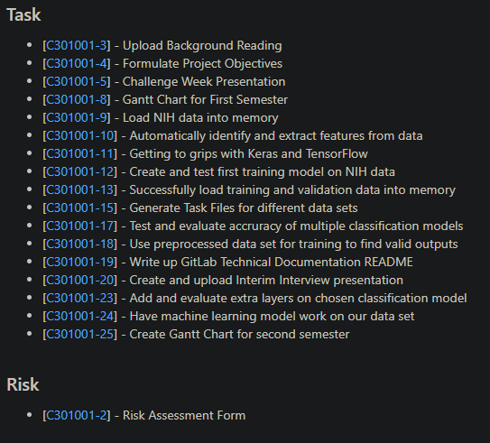
Kanban release “Classifier complete” overview

Slide 11
Spring term project objectives
The main objective for the spring term, in terms of code development, is to successfully develop a segmentation algorithm which would be able to identify infected malaria cells within a single sample slide containing other non-infected cells and subsequently measure its accuracy.
Firstly, we could re-use the methodology of loading the data into memory from the classification part of the project, as we are simply just using a different dataset. In this case we will be using the UCL dataset, an alternative option is to utilize task files as our source of data which would be created from the UCL dataset.
The theoretical approach to this challenge is to be able to preprocess the data in a similar way to the classifier, with methods such as data normalization in order to be compatible for the segmentation ML algorithm.
There however would be some key differences in the next approach as specific tools could/will need to be used, like annotation and augmentation tools which would identify the regions of interest in the preprocessed data before the training of the ML model can start.
After the training has been completed, evaluation techniques similar to ones used with the classifier should be used to let us understand the accuracy and preciseness of the machine learning model used.
The final step is to be able to feed the model unseen data and for it to be able to reasonably correctly identify parasitized samples among non-infected samples.

Slide 12
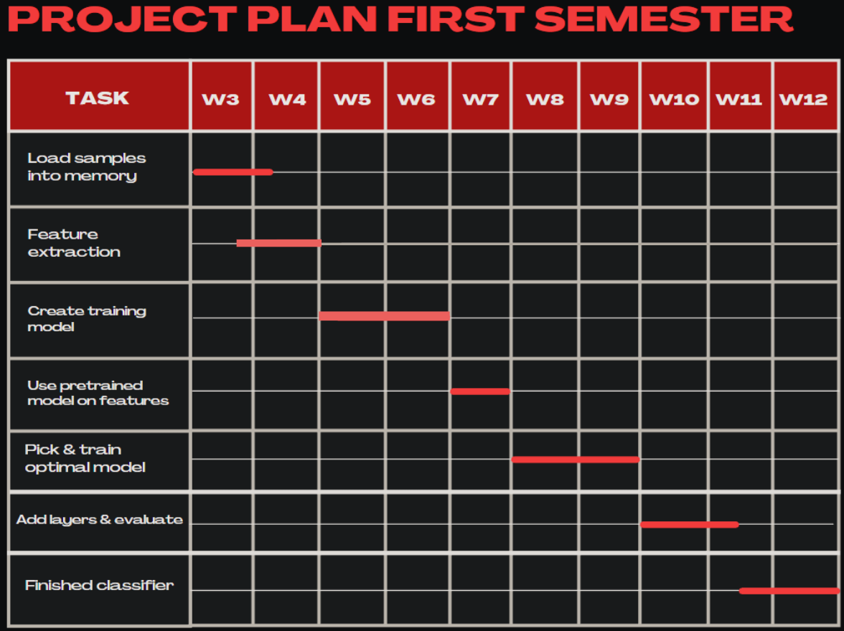
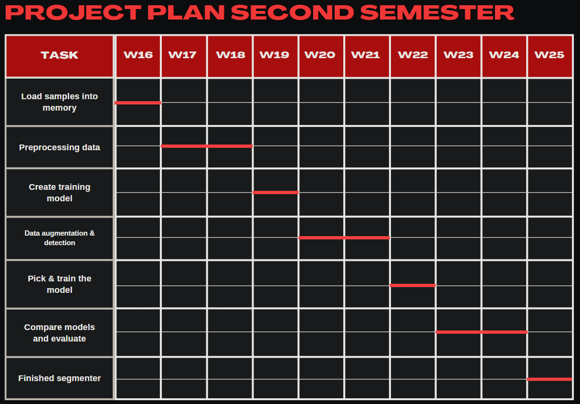
Previous & future project plans in Gantt Charts

Slide 13
Technical challenges encountered
Getting TensorFlow installed, and to successfully get GPU integration was a little bit painful
Data preprocessing and data processing was the most challenging part of the classifier, TensorFlow is very deliberate with what data it is willing to accept for its training models therefore many iterations of different data pipelines were tried and most of them ultimately failed.
One of the biggest problems was when training the model when the data was given to it would result in massive loss and extremely low accuracy.
I believed that I was initializing the model architecture incorrectly however it was the data pipeline that was at fault which I found out after a long time of debugging.
Some more advanced models require specific data preprocessing methods with their own keras.utility functions.
Difficult to switch between models due to them being picky about the data, and therefore some models might perform better with different data pipelines than others. This made the comparisons between models slightly more challenging.

Slide 14
Technical Demonstration

Slide 15
Q&A

